Slide 1
Lecture 11: Placement – I
Tsung-Wei (TW) Huang
Department of Electrical and Computer Engineering
University of Utah, Salt Lake City, UT
Notes:
Hello everybody, today we are going to move onto the next topic in Physical Design, placement. This is a very important stage to decide detailed locations of cells so you can have exact layout information about your chip.

Slide 2


Please Try to Attend Friday’s Seminar!

Slide 3
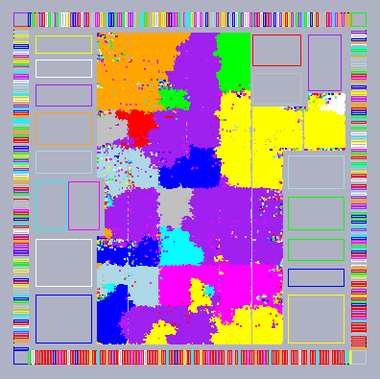
Physical Design Flow
Notes:
So far, we have talked about partitioning and floorplan, the two very important problems in the early stage of the physical design. You know, partitioning is to break a big circuit into several small parts so you can easily optimize your algorithm on individual partitions. Floorplan is to decide the rough locations or estimate the locations of partitions.
Within each partition, you have a bunch of gates, or the cells, you have implemented in programming assignment #1. We have to decide the locations for those cells as well. And, this is the goal of placement.

Slide 4
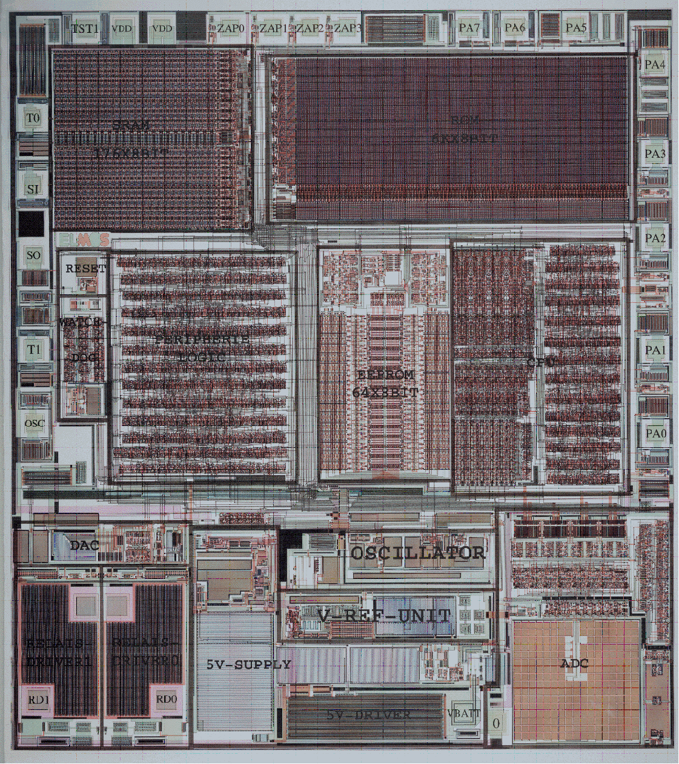
Placement
Places a netlist of gates and wires in a chip
Min wirelength
Min area
Min power
Min delay
…
Notes:
We want to place a netlist of gates or cells so we can have them wired. The input is therefore a netlist, you have many nets describing the connectivity among cells, and the goal is to place them in the chip such that each cell or each gate has its own location. Different cells do not overlap with each other.
What about the objectives? We know we can have many different locations for placing cells and gates that do not have overlap, and we need to find one solution that is most effective. So, we want to minimize wirelength, minimize the chip area, and minimize the power, timing, and so on.

Slide 5
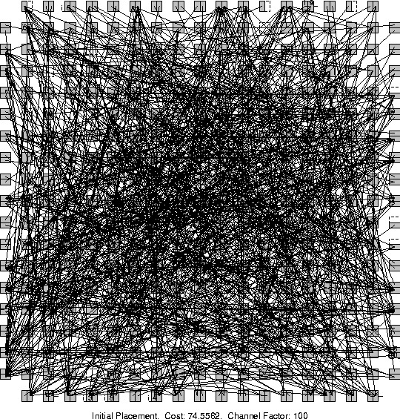
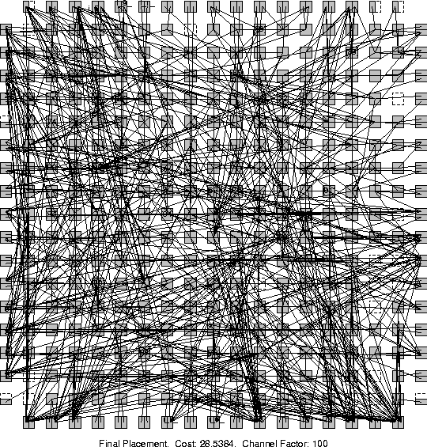
Example
Which placement result is better?
Notes:
Let’s take a look at a placement example. Which placement result is better?

Slide 6
Placement Problem
What does a placer do?
Input: Netlist of gates & nets
Output: Exact location of each gate
Goal: Able to route (connect) all wires
Placement is VERY HARD!
Large designs have 10-500M cells to place!
Bad placement → Much more wire
More wire: bigger, slower chip
If placement is very bad, next tool in the flow—the router—unable to connect all wires, or meet timing
Notes:
Let’s formally define the placement problem. (explain …)
The placement problem is really difficult and very hard. In practice, we have to deal with large designs that contain 10—500M cells to place. If you have a bad placement, you will need much more wire to connect cells together described in nets. But, what’s the problem about more wires?

Slide 7
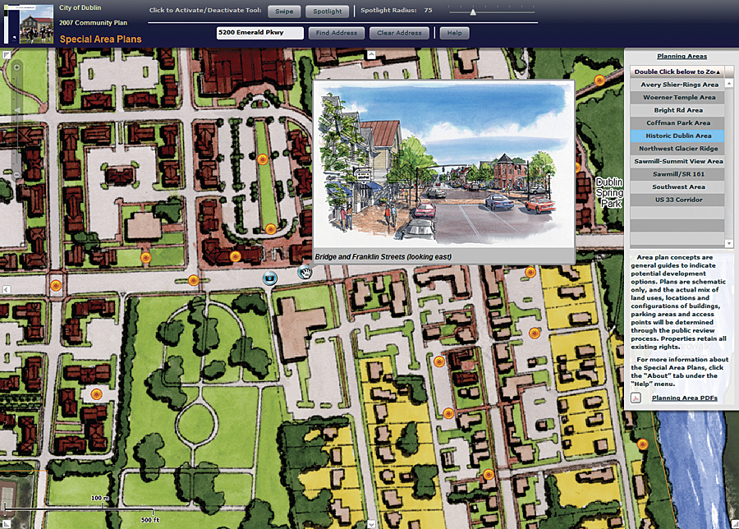
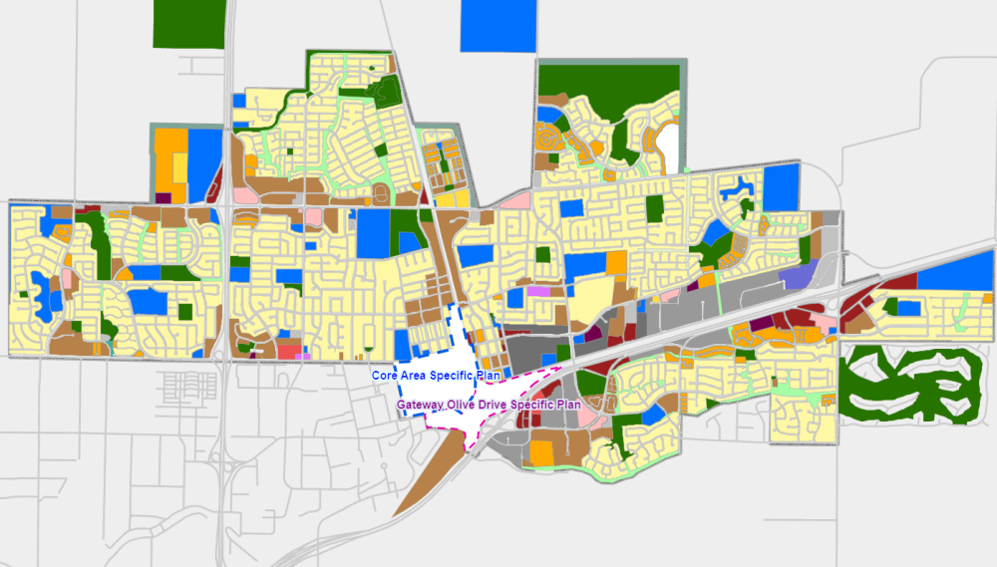
Analogy to City Planning
How to plan a city for 5-10M+ people?
Notes:
We can look at this problem from another angle. Imagine you are the city mayor or the state president and you want to build a new city from a place to accommodate 10 million people. You will need to decide a home for each family, and also their distance to the marketplace. How do you do that?
This is in fact, not very easy, because each family has its own preference, right? Just like a gate has a certain delay, timing, and power constraint, and we want to place millions of them while trying to make everybody happy.

Slide 8
Requirement for Placement
Must handle 10-100M cells, 1000s macros
64 bits + near-linear asymptotic complexity
Accept fixed ports/pads/pins + fixed cells
Place macros, esp. with var. aspect ratios
Non-trivial heights and widths (ex: height=2rows)
Honor targets and limits for net length
Respect floorplan constraints
Handle a wide range of placement densities
From <25% to 100% occupied
Notes:
The requirement for placement is summarized as follows: (explain …)

Slide 9
Requirement for Placement (cont’d)
Add / delete filler cells and Nwell contacts
Ignore clock connections
ECO (Engineering Change Order) placement
Fix overlaps after logic restructuring
Place a small number of unplaced blocks
Datapath planning services
Ex: many-core processor units
Provide dialog services to enable cooperation across tools
Ex: between placement and synthesis
Notes:
Not yet ending, in practice, like in commercial tools, you also need to deal with filler cells and Nwell contacts that describe constraints coming from the transistor level. (explain …)

Slide 10
Importance of Placement
Placement is a fundamental problem for physical design
Becomes very active again in recent years:
Many new academic placers since 2000
Many other publications to handle timing, routability, etc.
Reasons:
Serious interconnect issues (delay, routability, etc.) in advanced nodes
Placement determines interconnect to the first order
Need placement information even in early design stages (ex: logic synthesis)
Placement problem becomes significantly larger
Cong et al. [ASPDAC-03, ISPD-03, ICCAD-03] point out that existing placers are far from optimal, not scalable, and not stable
Notes:
Now you probably can already understand why placement is so important. Placement is a fundamental problem for physical design. If you cannot place things in your chip, it’s not possible to move on to the next stage.
Placement has become very active again in recent years and we have seen quite a lot of new academic placers since 2000 and many publications to handle various constraints in placement, such as timing, Routability, etc.
There are several reasons. First, today, we have very serious interconnect issues (explain …)
Also, the number of cells continues to grow every year. For example, one design my student is doing in his research, nvdla, has 500 million gates. How do we place them? You know, in PM1, we only have up to 100K cells to partition, and some of you already spend more than an hour to finish, right?

Slide 11



Industry-Academia Collaboration
Notes:
With this, there are a lot of industry-academia collaboration. You know, companies frequently organize competitions to seek novel placement solutions from the academia. For example, in ISPD 2015, Xilinx organized a placement competition for FPGA designs. ISPD 2017, Xilinx organized the competition again for clock-aware FPGA placement.
Very recently, in 2020, the start-up Cerebras organized a placement competition on their machine learning chips, asking you to place a given machine learning task graph or kernel graph on their chips.

Slide 12
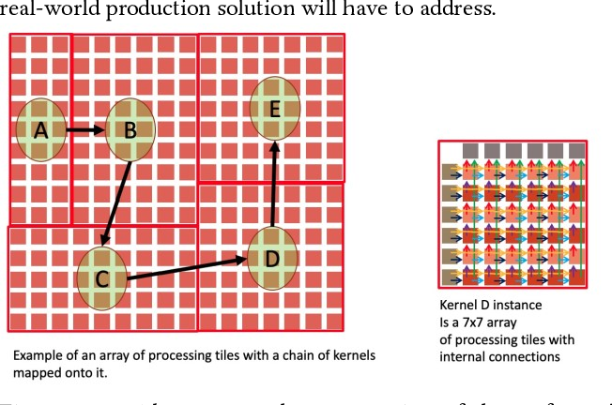
Placement for Different Design Styles
Standard cell placement (main focus of this course!)
Gate array / FPGA placement
Macro block placement
Typically called floorplanning
Mixed-size placement
A few large macro blocks
A large number of small cells
Wafer-scale placement
Thousands of processor units
Wafer-scale placement:
https://github.com/Cerebras/ispd2021
Notes:
There are many different design styles and their placement problems are all different. For example, we have standard cell placement, and this is the main focus of this course. In standard placement, every cell has the same height but different width. So your job is to decide locations for all cells on many rows. And these rows all have the same heights. That’s the problem for standard cell placement.
Another design style is gate array or FPGA placement. (explain …)

Slide 13
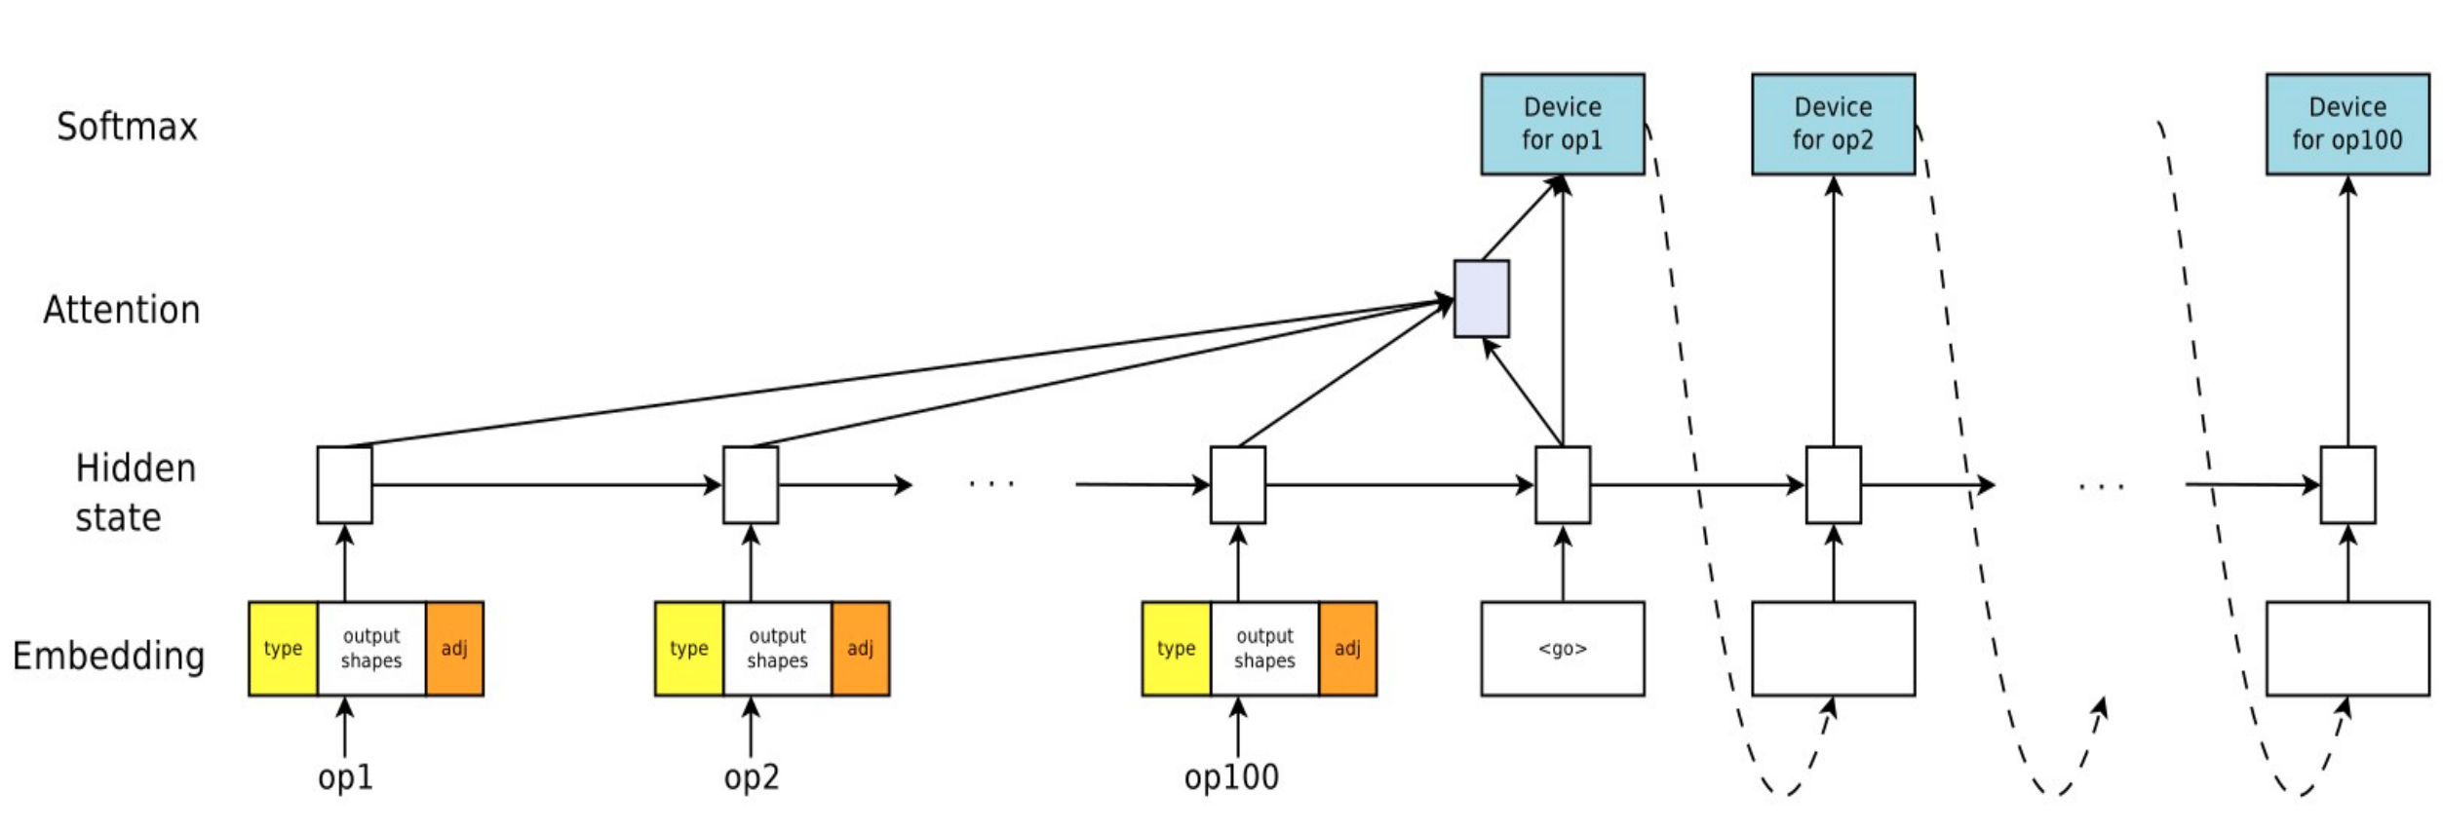
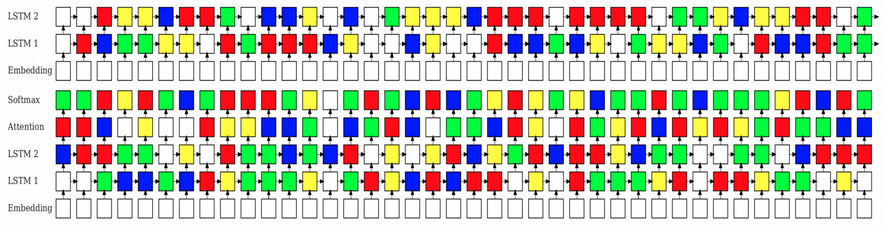
Placement in Machine Learning
GPU device placement optimization for neural networks
Place each tensor operator onto a GPU for improved performance
https://arxiv.org/abs/1706.04972
Notes:
Machine learning also has the placement problem. Given a kernel task graph that executes a learning model, how do you place them onto GPU?
For example, this is a paper published by google which essentially tries to decide which kernel goes to which GPU in optimizing the recurrent neural network. So, the job here is (explain …)

Slide 14
Placement Footprints
Standard Cell
Data Path
IP - Floorplanning
Notes:
You know, many footprints during the placement. For example (explain …)

Slide 15
Placement Footprints (cont’d)
Reserved areas
Mixed data path & sea of gates
Core
IO
Control

Slide 16
Placement Footprints
Perimeter IO
Area IO

Slide 17
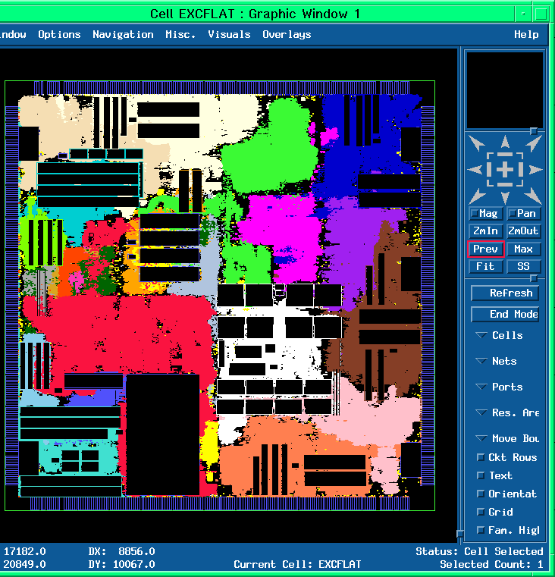
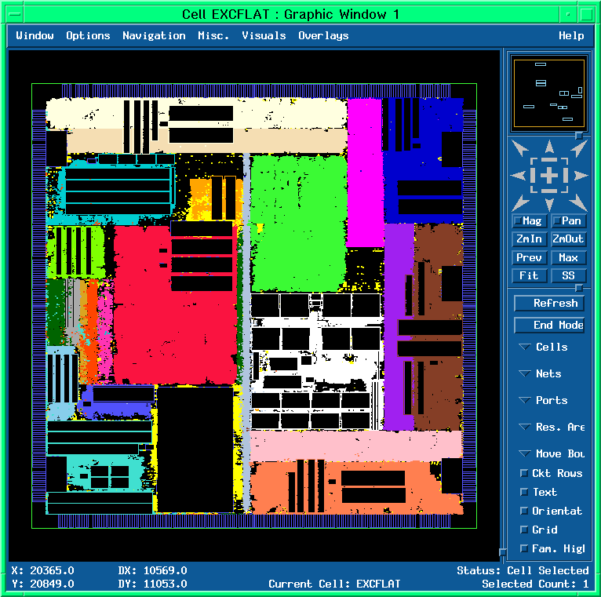
Commercial Tools

Slide 18
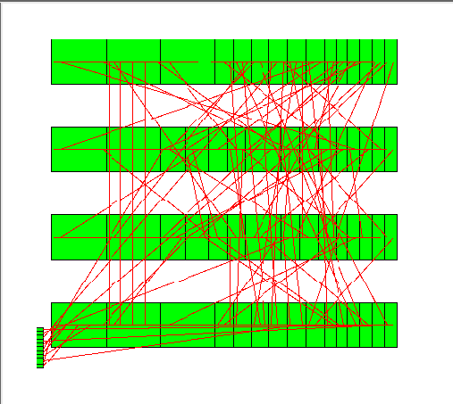
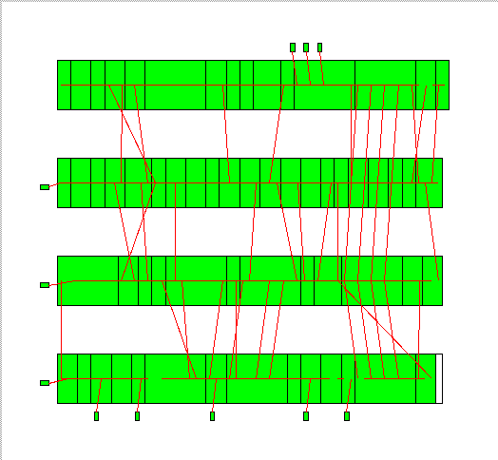
Placement is VERY HARD
Even this simplified placement problem is NP-complete
1D placement
2-pin nets only
All modules are of the same size
Wirelength as the only cost function
Realistic placement problems are
2D placement
Multi-pin nets
Modules of different sizes
Various cost function in addition to total wirelength
Various constraints for different target applications
bad placement
good placement
Notes:
As you can see there are many different types of constraint you need to consider during the placement, the problem of placement is VERY HARD! Even this simplified placement problem is NP-complete: If we just consider 1D placement, okay… (explain …)
But we know realistic placement problems are 2D, and they have many multiple-pin nets, you know each net connects to more than two pins, giving you the hypergraph. (explain …)

Slide 19
Let’s Start with a Simple Placer
Very simple model of the chip
A simple grid – like a chess board
Cells (gates) go in grid slots
Pins (connect off-chip, fixed at edges)
Very simple model of gates
All gates are exactly the same size.
Unrealistic, I know, but simplifies things …
Each grid slot can hold 1 gate
Unrealistic, again, but simplifies things …
Any gate can go in any slot
Notes:
Let’s start with a simple placer. We consider a very simple model of the chip. A simple grid, just like a chess board (explain …)

Slide 20
Objective of a Placer
Placer optimizes the ability of router to connect all the nets
But routers are computationally expensive tools. We can’t run one “inside” placer
We need a simplified approximation at this stage
Every real placer minimizes expected wirelength
For each wire in the design, estimate the expected length of the routed wire
Minimize this objective: ∑_{wires neti} EstimatedLength(net_{i})
Placer finds gate locations to minimize this objective
Notes:
The main objective of a placer is to optimize the ability of router to connect all the nets. This is often called Routability optimization because if your chip doesn’t get routed, it is useless. Now, you might ask, why don’t we just run a router inside the placer, you know, every time I place some cells, I run the router to tell me if it can be routed. Well, this is not practical, because routers are computationally expensive tools, and we can’t run an expensive router inside the placer. We need a simplified approximation at this stage.
In fact, every real placer minimize expected wirelength. (explain …)

Slide 21
Placement Terminology
Common term for a wire in a layout is called Net
The whole set of gates and wires is called netlist
Net categorized by how many things it connects.
A “2-point net”
A “4-point net”
y=5
4
3
2
1
0
y=5
4
3
2
1
0
x= 0 1 2 3 4
x= 0 1 2 3 4
Notes:
Let’s talk about some placement terminology. The common term for a wire in a layout is called Net. You have implemented this already in your programming assignment #1. Cells are connected by nets.
The whole set of gates or cells, and wires is called netlist. You have a list of nets and that is netlist. And, we categorize each net by how many things it connects. For example, we have 2-point net, the net connects to only two cells. Or, here, we have 4-point net, the net connects to four cells.
Now, how would you estimate the wirelength for a net? IF I give you a net like this or that, how would you estimate the wirelength?

Slide 22
Wirelength Estimation
Many different estimators for different placer methods
Multi-point nets can be routed in many different paths
In a dense layout, nets do not all get routed in a “shortest path”
y=5
4
3
2
1
0
y=5
4
3
2
1
0
y=5
4
3
2
1
0
x=0 1 2 3 4
x=0 1 2 3 4
x= 0 1 2 3 4
Notes:
There are many different ways to estimate the wirelength for a net and it also affects how you design a placer. Because we know for a multi-point net, we have many different ways to route it. And, in real situation, you are not just dealing with a single net, nets do not all get routed in a shortest path because you need to consider or save resources for other nets.

Slide 23
Half-perimeter Wirelength (HPWL)
Most placers adopt Half-Perimeter Wirelength (HPWL)
Also know as Bounding Box (BBOX) wirelength
Put smallest “bounding” box around all gates
Assume gate lives in “center” of the grid slot
Add width (∆X) and height (∆Y) of the BBOX for the wirelength estimate
A “2-point net”
A “4-point net”
y=5
4
3
2
1
0
y=5
4
3
2
1
0
∆X=3-1=2; ∆Y=4-1=3. HPWL=5
∆X=4-1=3; ∆Y=5-1=4. HPWL=7
x=0 1 2 3 4
x=0 1 2 3 4
Notes:
For this course, we are going to focus on the very common and popular wirelength model, the half-perimeter wirelength (HPWL) model. HPWL is the widely adopted model by most placers. (explain …)

Slide 24
About HPWL
Easy to calculate, even for a multi-point net:
[max{X coordinates of all gates) – min{X coordinates of all gates}] + [max{Y coordinates of all gates) – min{Y coordinates of all gates}]
Always a lower bound on the real wire length
No matter how complex the final routed wire path is…
…you need at least this much wire to connect everything
Aside: all wiring on big chips (and most boards) is strictly horizontal & vertical – no “arbitrary angles” for manufacturing reasons which is another reason HPWL is good
Notes:
The main reason for using HPWL as our wirelength estimation is its easiness. HPWL is very easy to calculate, even for a multi-point net, because we can just calculate the maximum x-distance among gates and the maximum y-distance among gates, and then sum the two numbers up.
Is there any other advantage for using HPWL besides simplicity? (ask and click)
More importantly, HPWL is always a lower bound on the real wire length if you want to go through the shortest solution.

Slide 25
About HPWL (cont’d)
Real distribution of HPWL for 200K gate IBM ASIC [DAC97]
181K nets. Note LOG scale. Most nets are short. But there is a long tail to distribution.
Number of nets
HPWL
Notes:
In real design, most nets are of short wirelength. Here in this slide I show you the distribution of wirelength in terms of HPWL and how many nets the design has in that HPWL. (explain …)

Slide 26
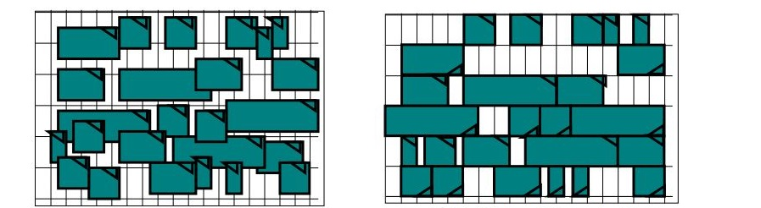
How would You Solve Placement?
Notes:
Now we have understood the problem formulation and objective. Before we move on, let’s take a few minute thinking, how would you solve the placement problem.

Slide 27
A Simple Iterative Placer
Start with a random placement
Just randomly assign each gate to a grid location (1 gate per entry)
Yes – this is a terrible placement. Really big L = ∑_{nets Ni} HPWL(Ni)
Random iterative improvement
Pick a random pair of gates in the grid and swap their locations
Evaluate the change in
L = ∑_{nets Ni} HPWL(Ni);
ΔL= [new HPWL – old HPWL]
If ΔL<0, new L got smaller → Improvement! Keep this swap
If ΔL>0, new L got bigger → Worse! Undo this swap
Keep doing this for many, many random swaps, until L stops improving
Notes:
Well, when you are designing an algorithm, always start with greedy. We start with an initial solution, and iteratively improve it based on some random operations, just like what you did in PA1 for implementing the FM. Then, we stop the iterations when no improvements are available.
(explain …)

Slide 28
A Simple Iterative Placer: Pseudocode
foreach( gate Gi in netlist ) //random initial placement
place Gi in random location (x,y) in grid not already occupied
L=0 //calculate initial HPWL wirelength for whole netlist
foreach( net Ni in the netlist )
L = L + HPWL(Ni);
while ( overall HPWL wirelength L is improving ) { //main improvement loop
pick random gate Gi; pick random gate Gj;
swap gates Gi and Gj
evaluate ΔL = new HPWL - old HPWL;
if ( ΔL < 0 ) { // improved placement! Update HPWL
L = L + ΔL
else // ΔL > 0, this is a worse placement
undo swap of Gi and Gj
}
Notes:
This slide shows you the pseudo code for this simple iterative placement algorithm. Very simple. (explain …)
Now, if you implement this algorithm, what are the details you need to pay attention to?

Slide 29
Computing ΔL Efficiently (Incrementally)
Incremental wirelength update calculation
Cannot afford to re-compute length of each net in entire placement after each swap! – most nets did not change
Compute ΔL incrementally – just look at nets that could change
ΔL = [ HPWL(i) + HPWL(j) + HPWL(k) after swap] - [ HPWL(i) + HPWM(j) + HPWL(k) before swap]
y=5
4
3
2
1
0
Net i
y=5
4
3
2
1
0
Net i
Swap
Gates 1,2
Net k
1
2
Net j
Net k
Net j
2
1
x=0 1 2 3 4
x=0 1 2 3 4

Slide 30

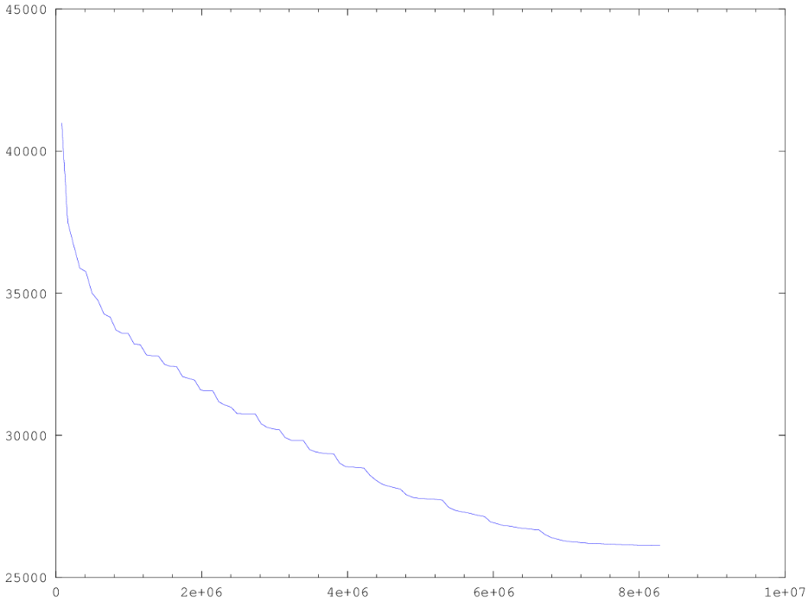
How does this Simple Placer Work?
It works ok …
Small benchmark
~2500 gates + ~500 pins
Placed in a 50x50 grid
Graph shows progress
Y axis: L = ∑_{nets Ni} HPWL(Ni)
X axis: # swaps
Yes, this ran for 8M swaps until progress on L stopped
L = ∑_{nets Ni} HPWL(Ni)
# random gate swaps→
Notes:
How does this simple iterative placer work? Well, it actually works ok… only for small benchmark like about 2500 gates and 500 pins, placed in a small grid 50 x 50.
Here I have the figure showing you the progress of the improvement. The x axis shows the number of swaps and the y-axis shows the decrease of wirelength. Of course, the more swaps you perform, the better the solution because it is a greedy method.
And, you can probably imagine, this iterative process will be very long! For example, here we will end up with 8M swaps!!! Until the progress on wirelength converge or stop. Keep in mind we only have 2K gates, a very small design. If you have a big design like several millions of cells or gates to place, it will run forever.

Slide 31
Takeaways for the Simple Placer
Easy to understand and to implement
Start with a random placement and randomly improve the wirelength until it stops getting better
Can optimize what we care about: estimated wirelength ∑_{nets Ni} HPWL(Ni)
It will improve at each iteration always
However, the final result is still not very good
We are being too greedy to go out of the local optimal
We can do better for sure
Notes:
Takeaways for the simple placer. (explain …)

Slide 32
Problem of the Simple Placer?
Imagine you could plot ∑HPWL for all possible placements
Our random method only takes swaps that improve wirelength
Can only find good results downhill from our random start
Easy to get stuck in a local minimum
∑HPWL
(lower is better)
If there are better answers, how to find?
All possible placement solutions we could find

Slide 33
Downhill and Uphill Movement
If we could go uphill, we may get better placements
How to control this?
∑HPWL
(lower is better)
All possible placement solutions we could find

Slide 34
Simulated Annealing (SA)-based Placer
Annealing temperature cooling “outer loop”
Start with a random initial placement with wirelength = ∑HPWL(net)
T = temperature = hot; frozen = false;
while ( ! frozen ) {
for (s=1; s< M* #gates in layout; s++) { // M is how many swaps-per-gate
Swap 2 random gates Gi and Gj
Compute ∆L = [∑HPWL(net) before swap] - [∑HPWL(net) after swap]
if (∆L < 0 )
then accept this swap //this is a new, better placement
else {
if( uniform_random() < exp( -∆L/T ) )
then accept this ‘uphill’ swap //this is a new, worse placement
else undo this ‘uphill’ swap
}
if (∑HPWL(net) still decreasing over the last few temperatures)
then T = 0.9 * T // cool the temperature; do more gate swaps
else frozen = true
}
return (final placement as best solution)
New: Probabilistic swap accept

Slide 35
Neighboring Solutions
.
M1: Displace a module to a new location
.
M2: Swap two gates
M3: Change the orientation of a macro, if any
1 2
2 1
Axis of reflections
1 2
3 4
3 4
3 4

Slide 36
Move Selection Strategy
Select a move between M1 and M2
Prob(M1)=4/5
Prob(M2)=1/5
If a move of type M1 is chosen and is rejected
Take a move of type M3 (for the same gate) with probability 1/10
Restriction on
How far a module can be displaced
What pairs of modules can be interchanged
M1: Displacement
M2: Interchange
M3: Reflection

Slide 37
Move Restriction
Range Limiter
At the beginning, R is very large, big enough to contain the whole chip
Window size shrinks slowly as the temperature decreases. In fact, height and width of R ∝ log(T)
Switching move begins when window size are so small that no inter-row modules interchange is permitted
Rectangular window R

Slide 38
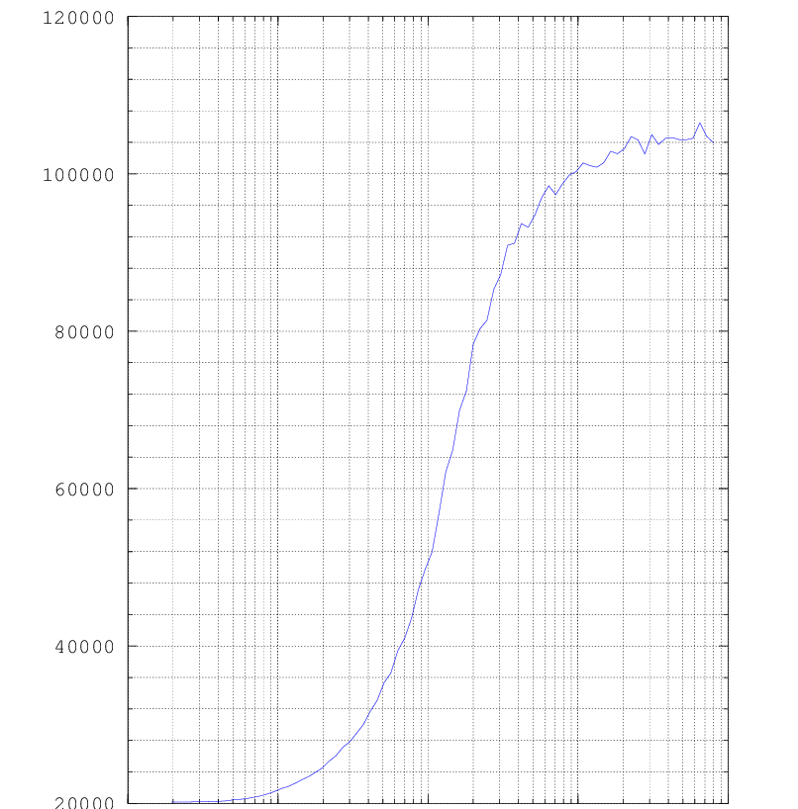
How does an SA-based Placer Work?
It works better
Same 2500 gate benchmark
HOT=800, M=100 moves/gate
About 30% less HPWL wirelength compared to the simple placer
Typical annealing “cost” curve
X axis is T=temperature, LOG scale
Do 100x2500 swaps/temperature
Read right-to-left
Y axis is ∑HPWL, but LOG scale
Cool fact: curves always look like this!
120K
∑HPWL
100K
80K
60K
← Placer progress
40K
T→
20K
0.1
1
10
100
1000

Slide 39
Problem of SA-based Placer
Simulated annealing is a very successful method
Much better than dumb random improvement
Dominant method for placers in 1980s, 1990s
And still today – used in lots of other VLSI CAD tasks (e.g., partitioning, floorplanning, etc.)
However, this is not not how we really do placers today
Annealing works well for up to 100K – 500K gates
Annealing too inefficient for things with 1M+ gates
Today’s designs can easily have 500M+ gates
We need another new set of ideas
Notes:
Simulated annealing is a very successful method for improving greedy-based iterative placement algorithm. You know, it’s much better than dump random improvement and has been one dominant method for placers in 1980 and 1990. And still SA is being used very often today, in many other VLSI CAD tasks, partitioning, floorplanning, etc.
But this is not how today’s placement tool is doing. Why? (ask and click)

Slide 40
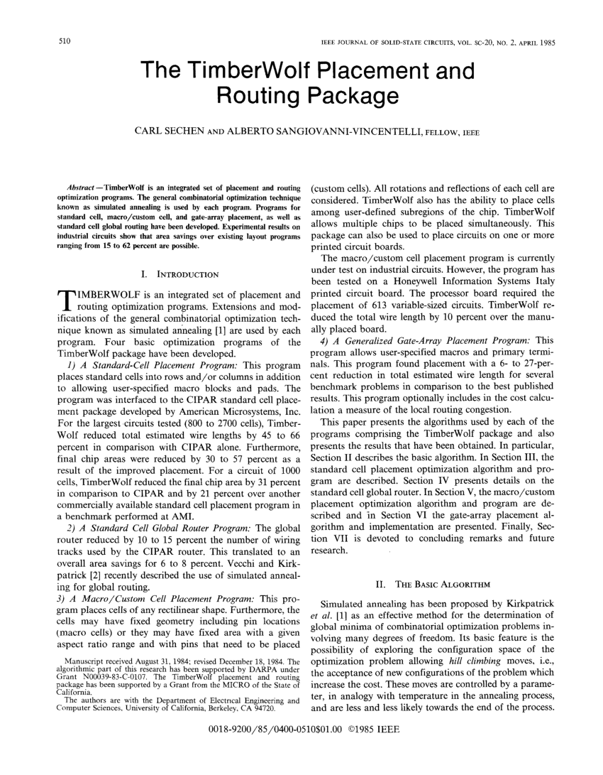

A Famous SA-based Placer: TimberWolf
http://www.twolf.com/
“The Timberwolf Placement and Routing Package”, Sechen, Sangiovanni; IEEE Journal of Solid-State Circuits, vol SC-20, No. 2(1985) 510-522

Slide 41
Summary
We have discussed basic ideas of placement
We have discussed importance and difficulty of placement
We have discussed the problem formulation of placement
Terminology
Input, output, objective
Wirelength estimation
We have discussed two simple placement solutions
Random iterative improvement-based placement algorithm
Simulated annealing-based placement

